Slide 2
Overview
My journey
Master thesis project
Why this lab?

Slide 3



Vishal Kannan
Integrated Masters in Bioengineering and Medical Nanotechnology
Masters in Integrative Neuroscience

Slide 4


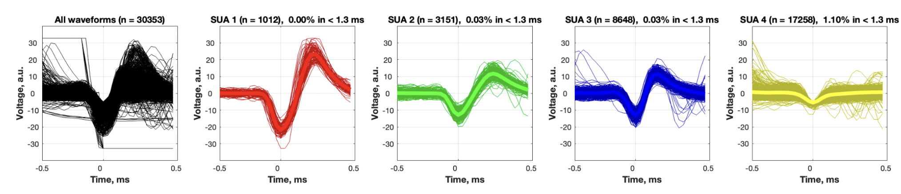


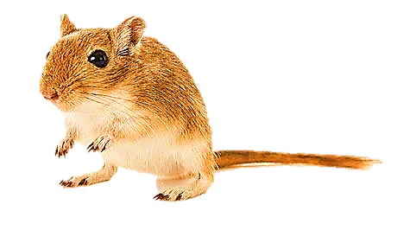
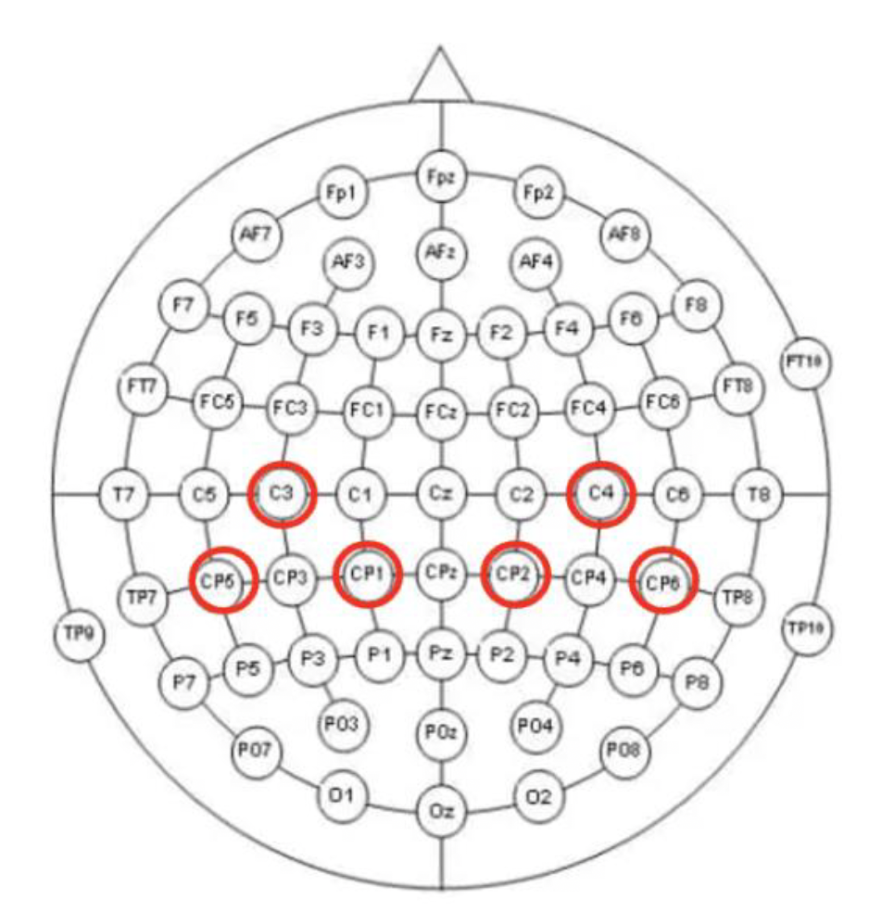


Research experience
Offline spike sorting
How does altering single-cell and population-level activity affect a monkey’s working memory?
Learning and memory
Spatial audio setup with a software interface
Sensory perception
How does sound localization help in perceiving spatial audio?
How does sensory integration in a Gerbil’s auditory cortex guide an animal’s decision in a changing environment?
Cognitive flexibility
Time frequency analysis and statistics
De-trend fluctuation analysis and supervised learning
Clinical rehabilitation
Potential classification feature to design a brain-computer interface for post-stroke rehabilitation
How do neuronal activity patterns in the frontal cortex shape an animal’s adaptive decision-making behaviour in a foraging task?
Adaptive decision making
Current work (Master thesis)

Slide 5
Research experience
Offline spike sorting
How does altering single-cell and population-level activity affect a monkey’s working memory?
Learning and memory
Cognitive flexibility
How does sensory integration in a Gerbil’s auditory cortex guide an animal’s decision in a changing environment?
Time frequency analysis and statistics
De-trend fluctuation analysis and supervised learning
Clinical rehabilitation
Potential classification feature to design a brain-computer interface for post-stroke rehabilitation
How do neuronal activity patterns in the frontal cortex shape an animal’s adaptive decision-making behaviour in a foraging task?
Adaptive decision making
Current work (Master thesis)

Slide 6



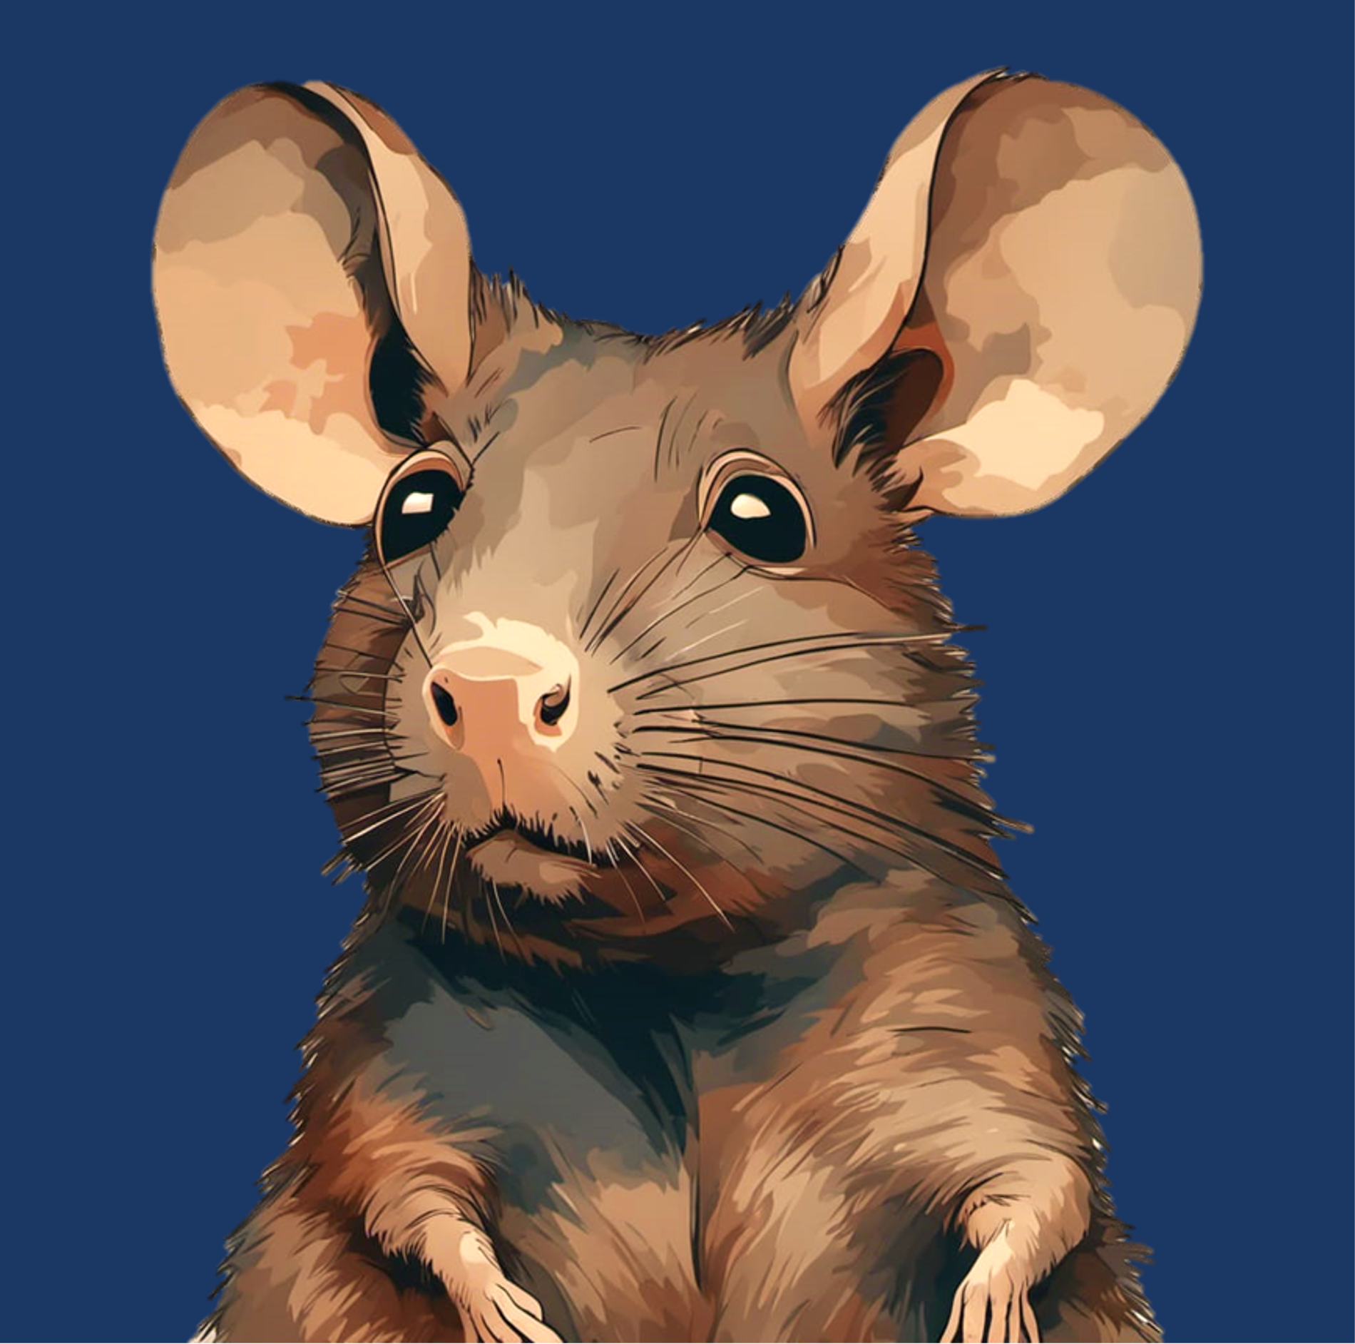



Slide 7
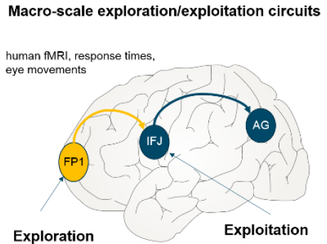
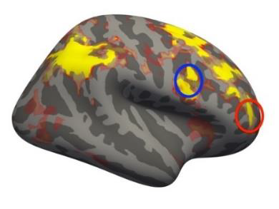

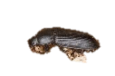



Background
Neural substrates for exploratory behaviour
Frontopolar cortex in humans – Gambling studies (Daw et al., 2006 ) (Raja Beharelle et al., 2015)
aPFC in Monkeys (Mansouri et al., 2015)
Rodent model – Mongolian gerbils
The Situation
Frontal region A (FrA) – analogous to Frontopolar cortex
Exploitation
Exploration
(Shuai and Song, 2011)
Notes:
We often must choose whether to try something new (exploration) or stick with a proven strategy (exploitation). Balancing this trade-off is important for survival and growth across species because, without exploration, we would perseverate with the same strategies and never discover better options. Which brain mechanisms are responsible for our ability to make these decisions?
Humans are remarkably curious, and that is useful in helping us to learn about new environments and possibilities. But curiosity killed the cat, they say, and it also carries with it substantial potential risks and costs for us. Statisticians, engineers and economists have long considered ways of balancing the costs and benefits of exploration.

Slide 8
Objective
To obtain insights into different neuronal circuit functions in the frontal cortex that contribute to optimal selection of exploitative versus explorative search strategies.
Ramping in overall activity of FrA before patch-leaving decision
Investigate if allocation of exploration or exploitation strategies differentially orchestrates the FrA circuitry in a layer-dependent manner

Slide 9
Objective
To obtain insights into different neuronal circuit functions in the frontal cortex that contribute to optimal selection of exploitative versus explorative search strategies.
Ramping in overall activity of FrA before patch-leaving decision
Investigate if allocation of exploration or exploitation strategies differentially orchestrates the FrA circuitry in a layer-dependent manner

Slide 10
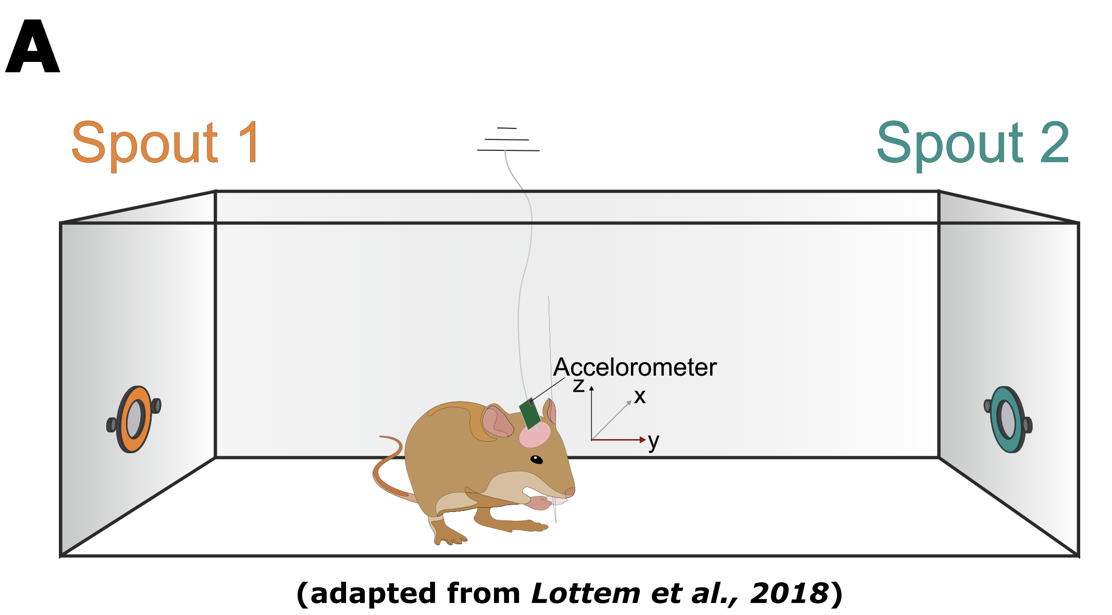
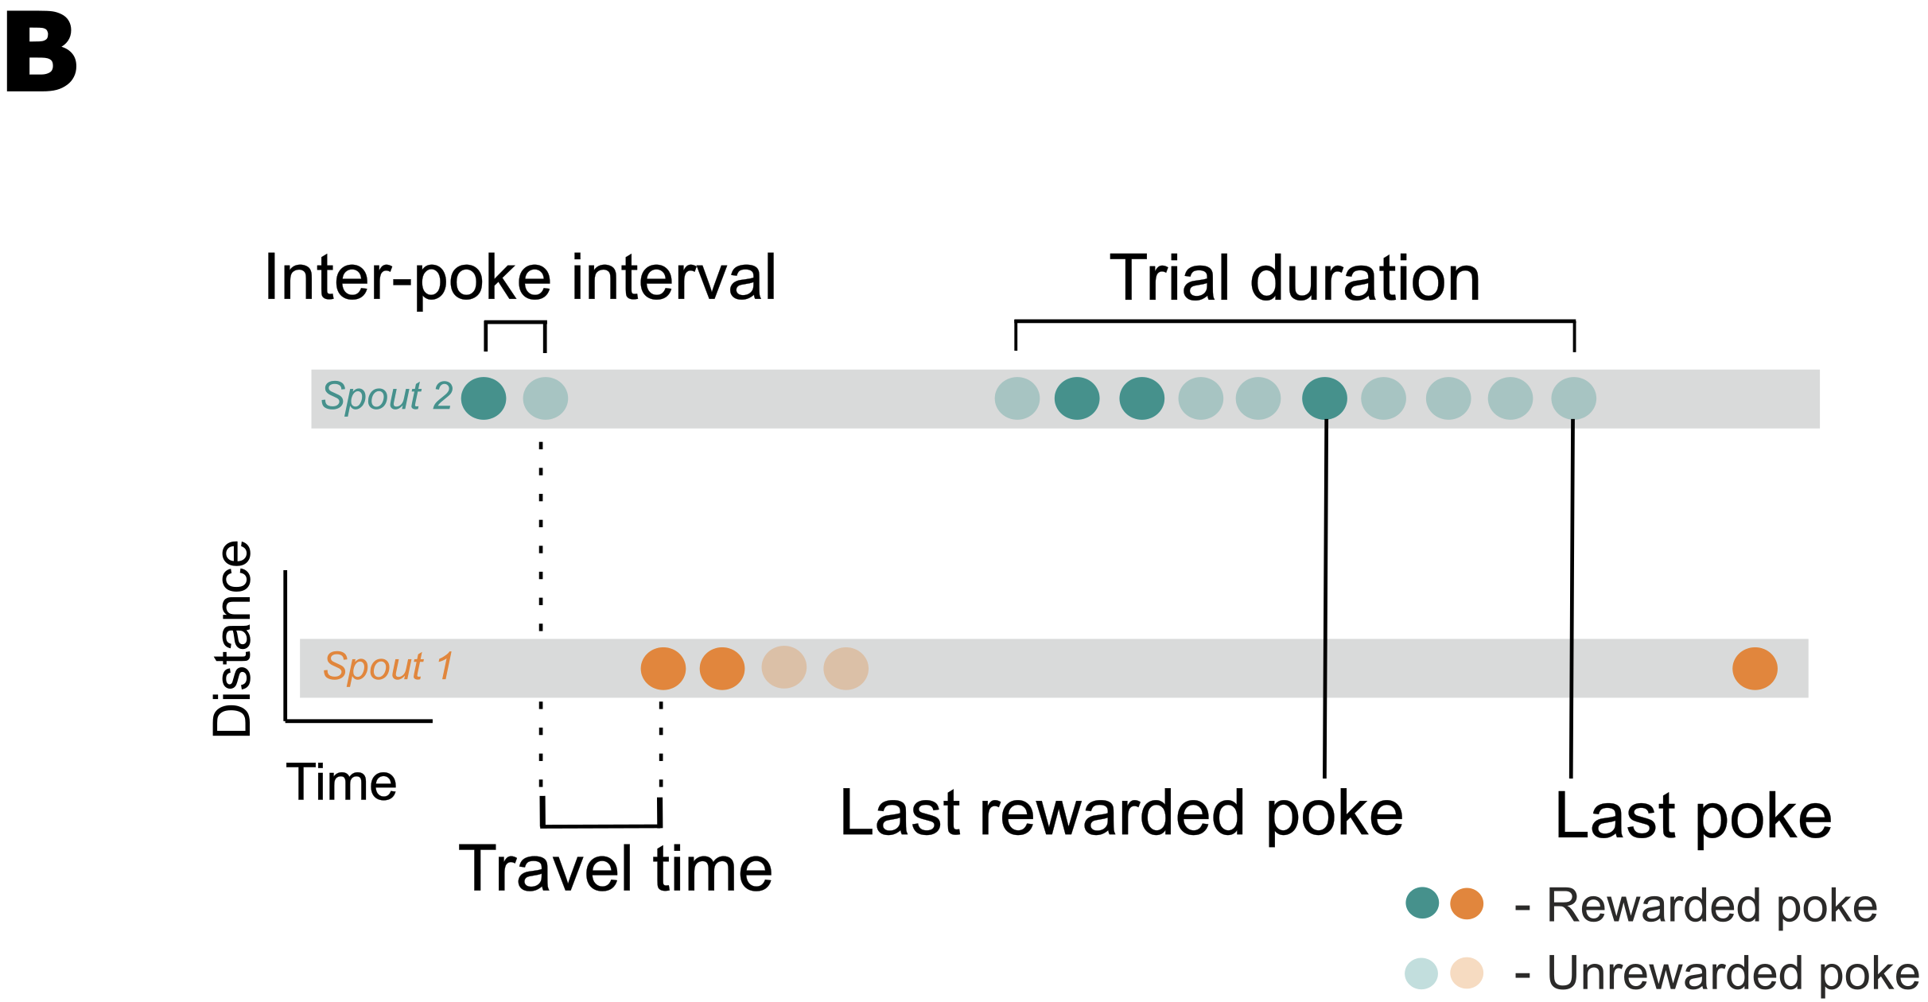
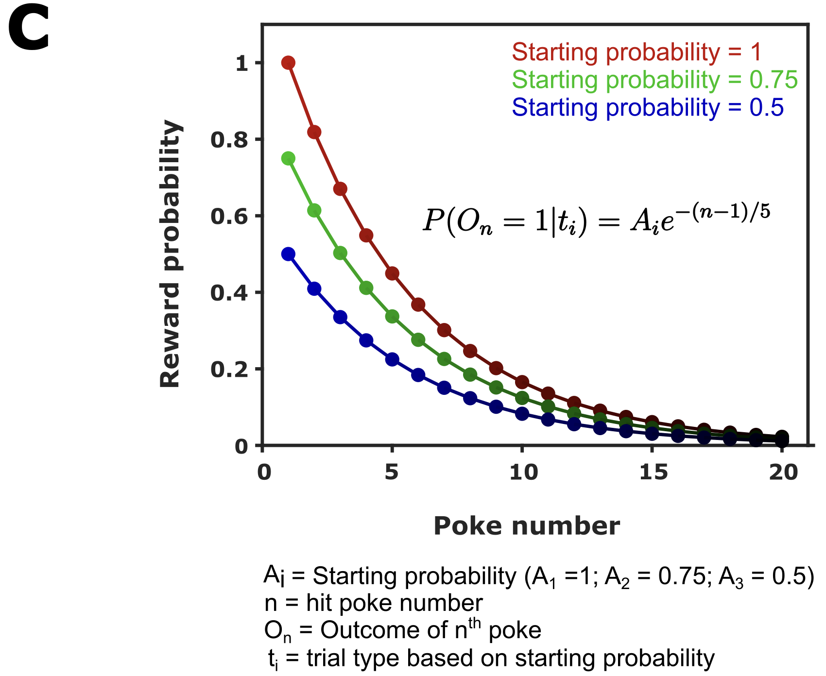
The probabilistic foraging task
?
Behaviour video

Slide 11
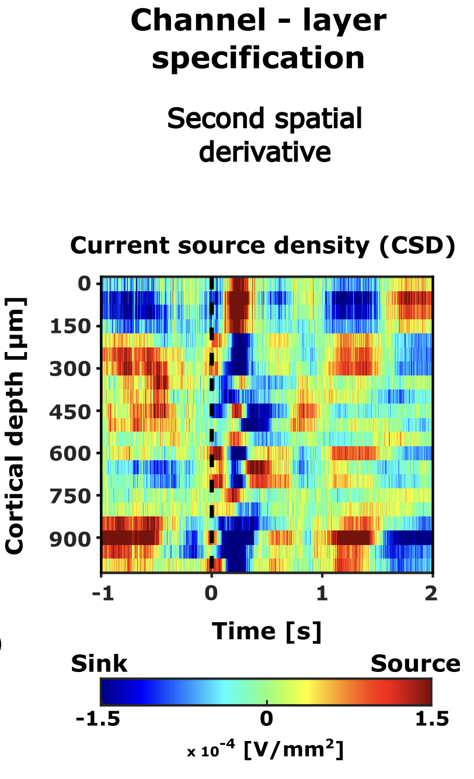
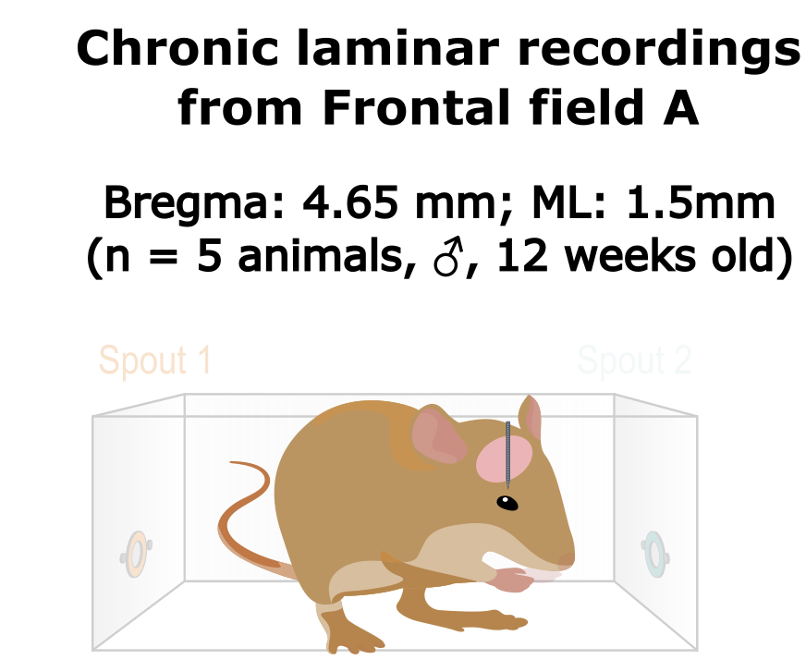
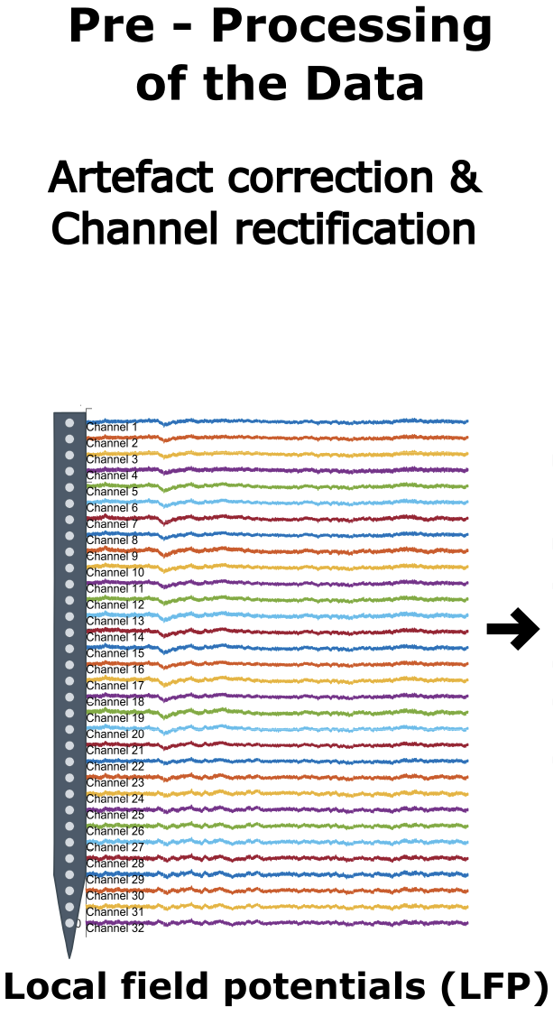
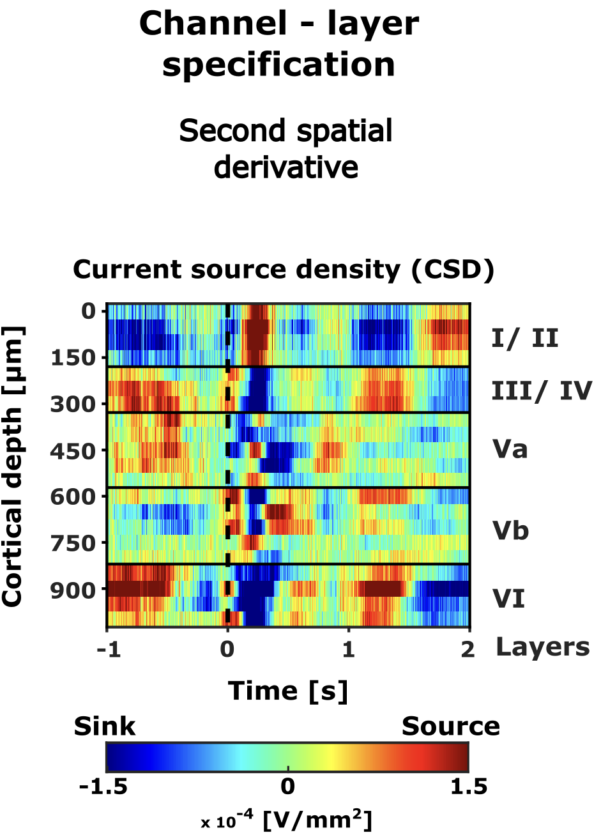
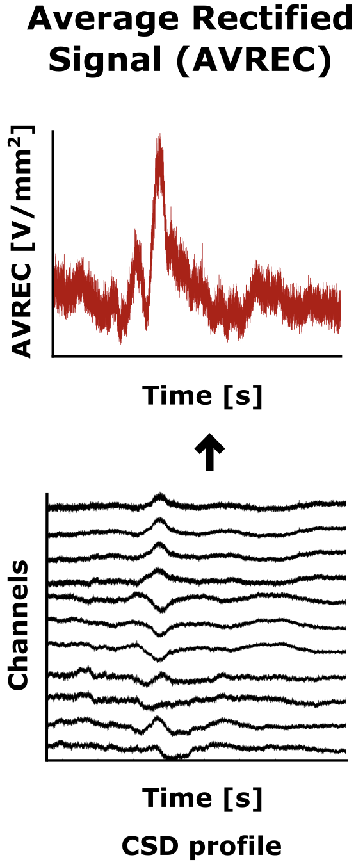

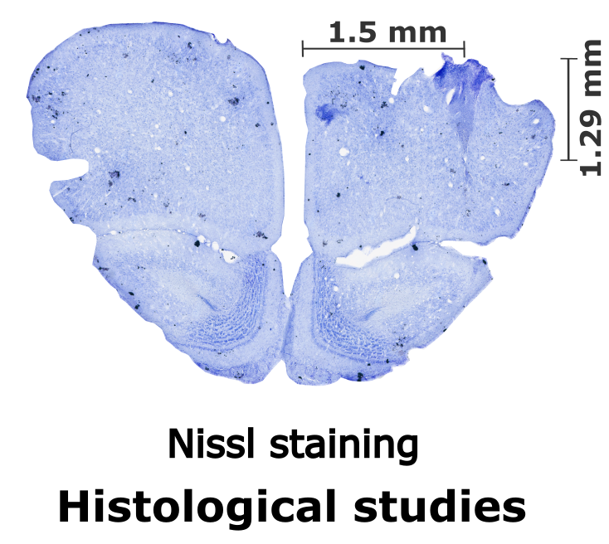
How do we study this?

Slide 12
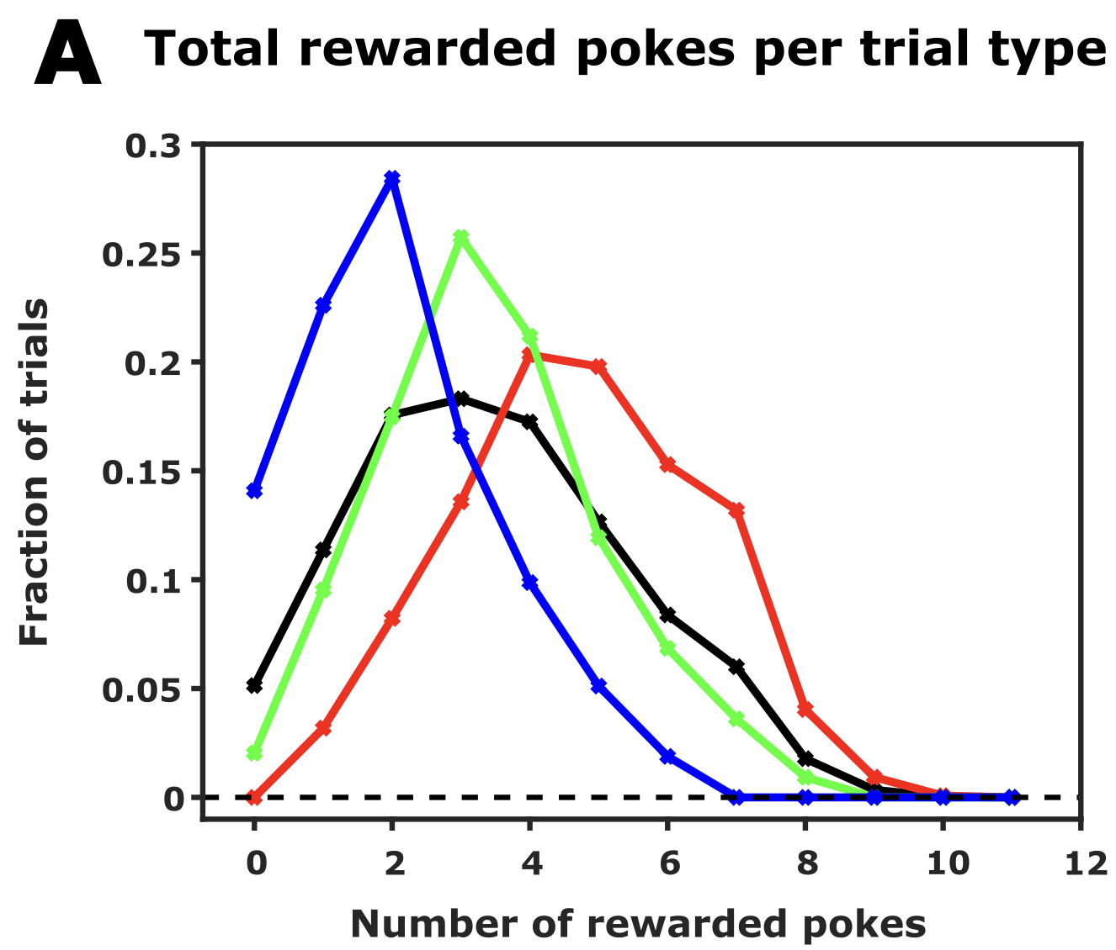
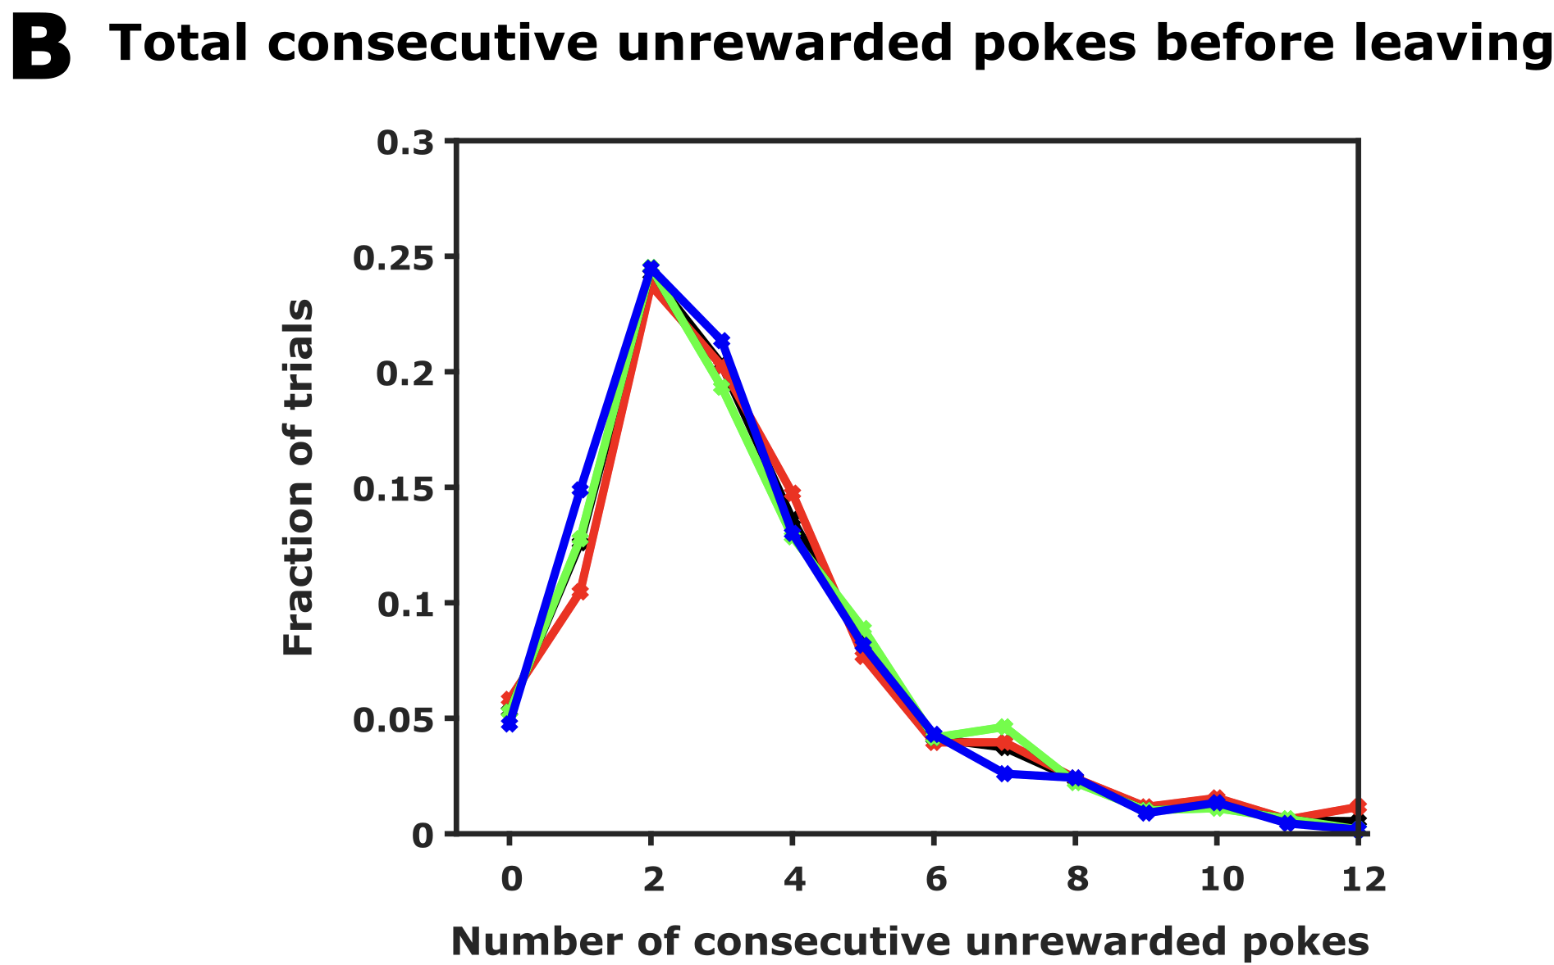
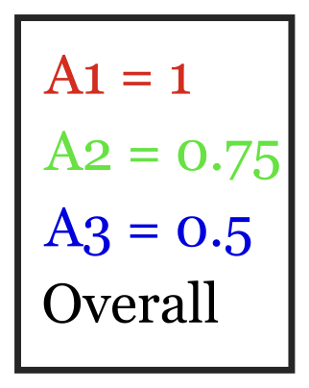
Animals make inference-based decision
How does the animal behave?
Number of consecutive unrewarded pokes before leaving is independent
of starting reward probability and total number of rewards received in a trial.

Slide 13
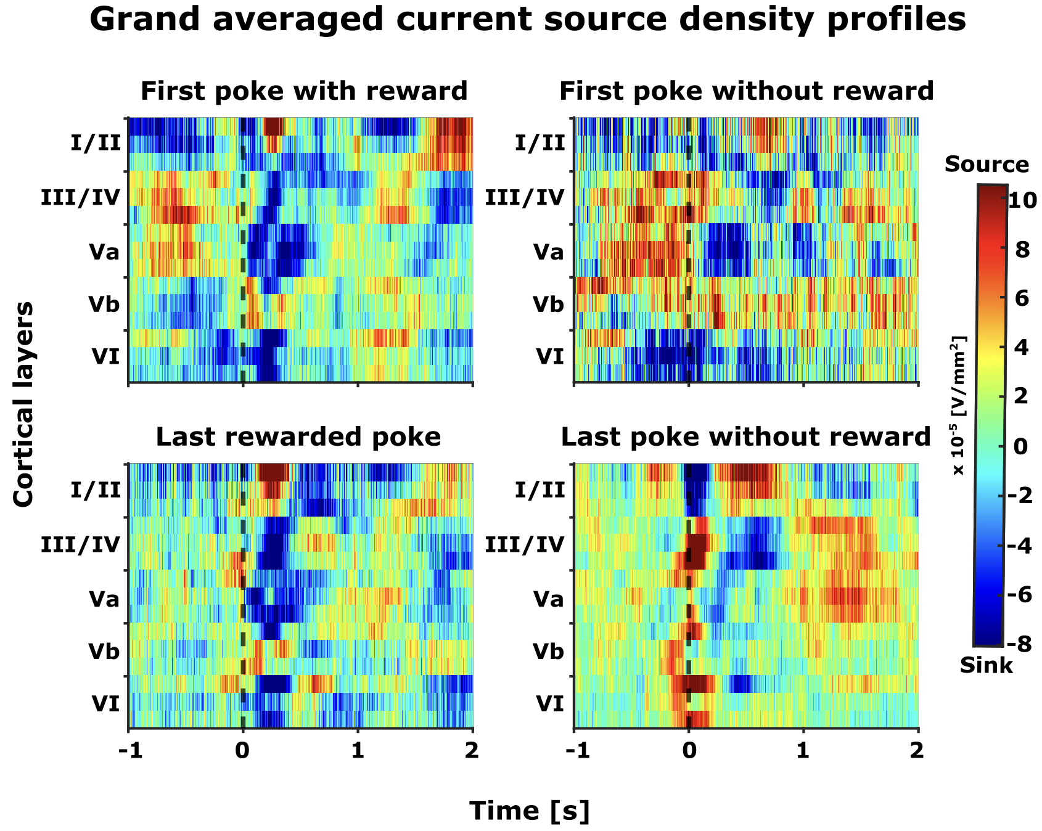
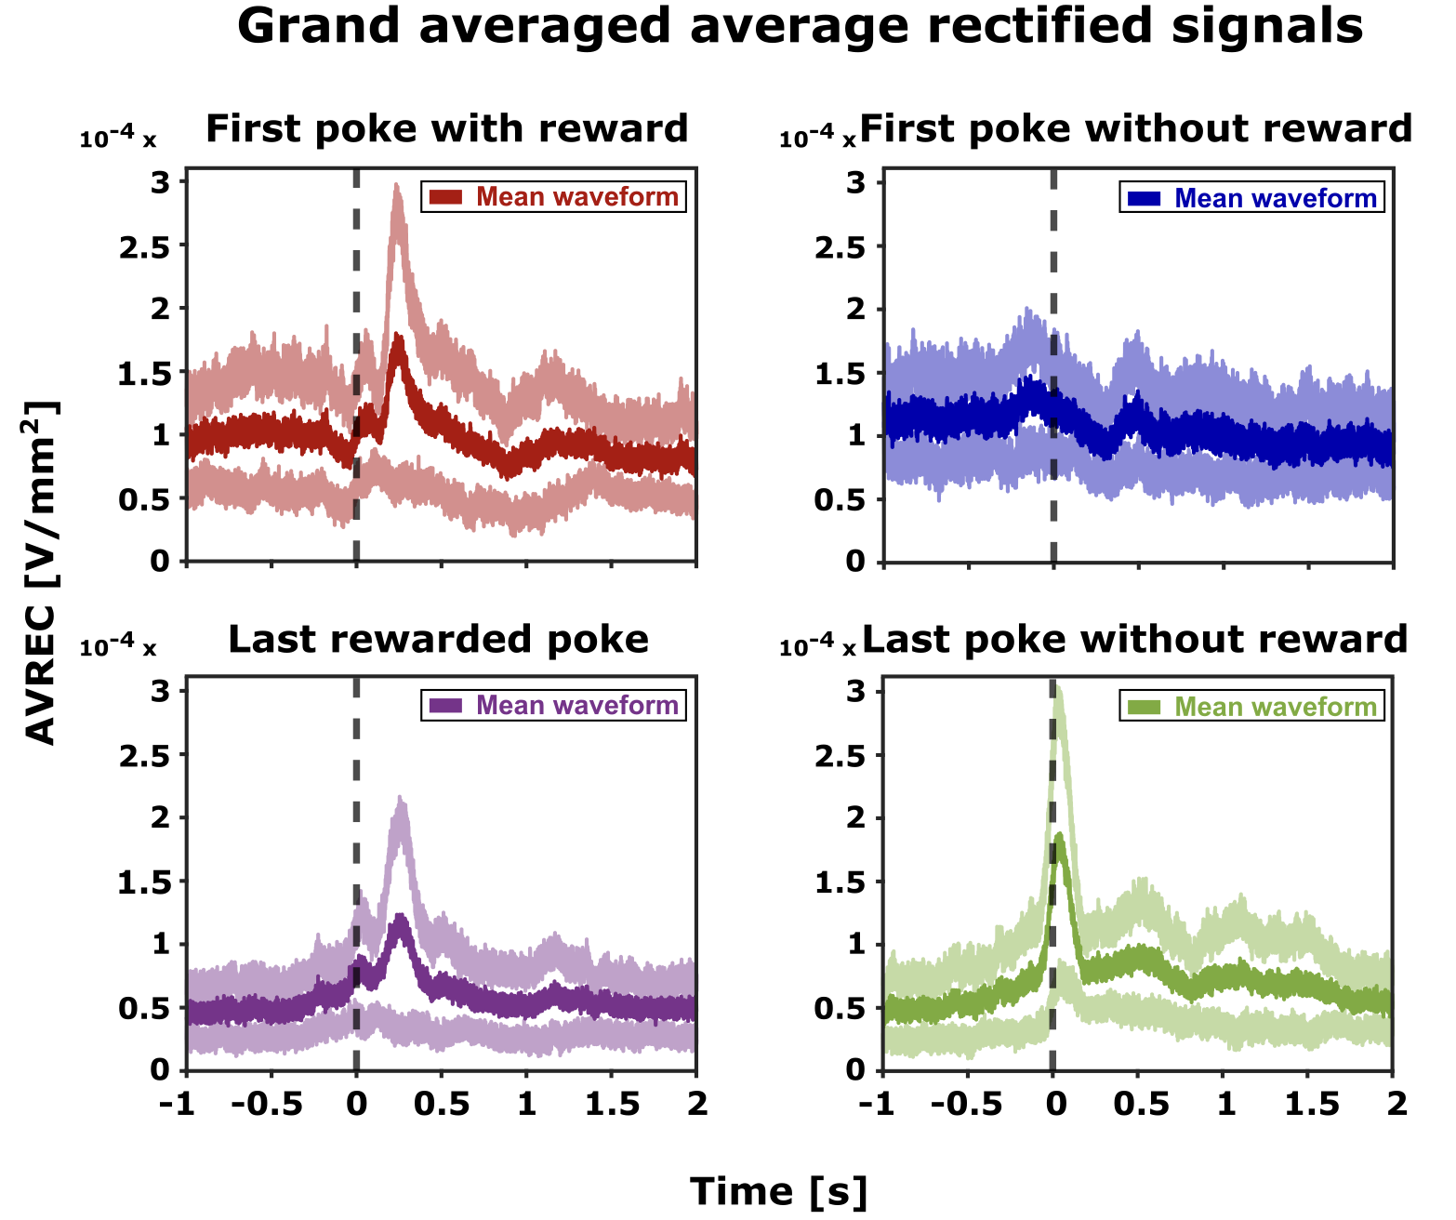
Distinct motor and reward related frontal activity

Slide 14
Distinct motor and reward related frontal activity

Slide 15
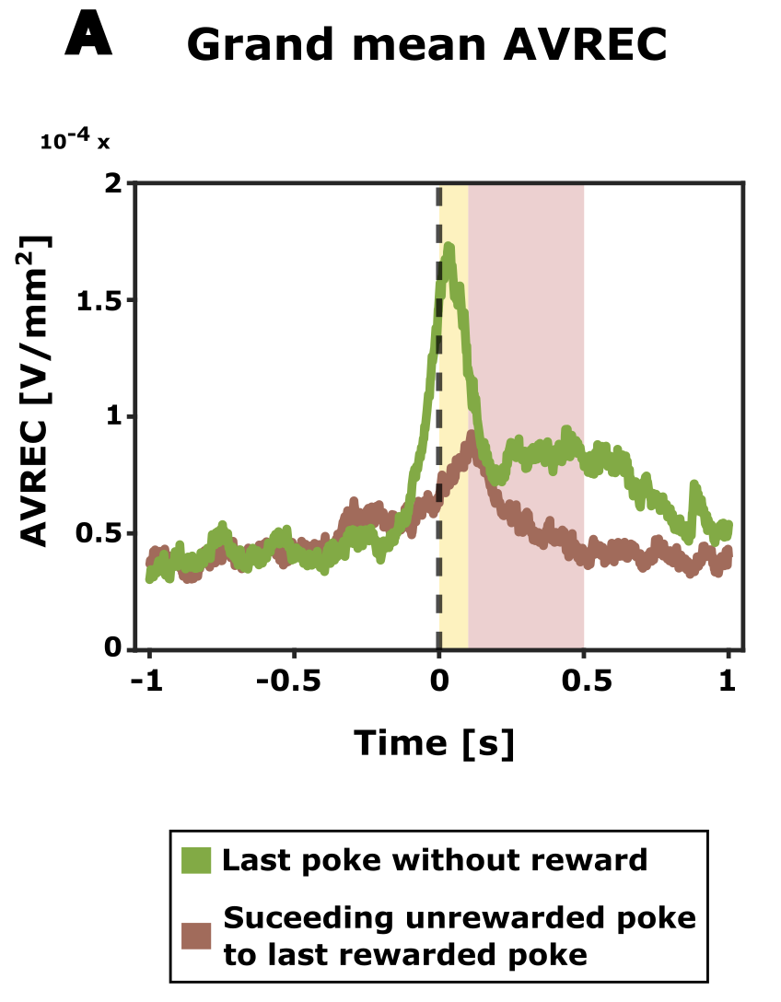
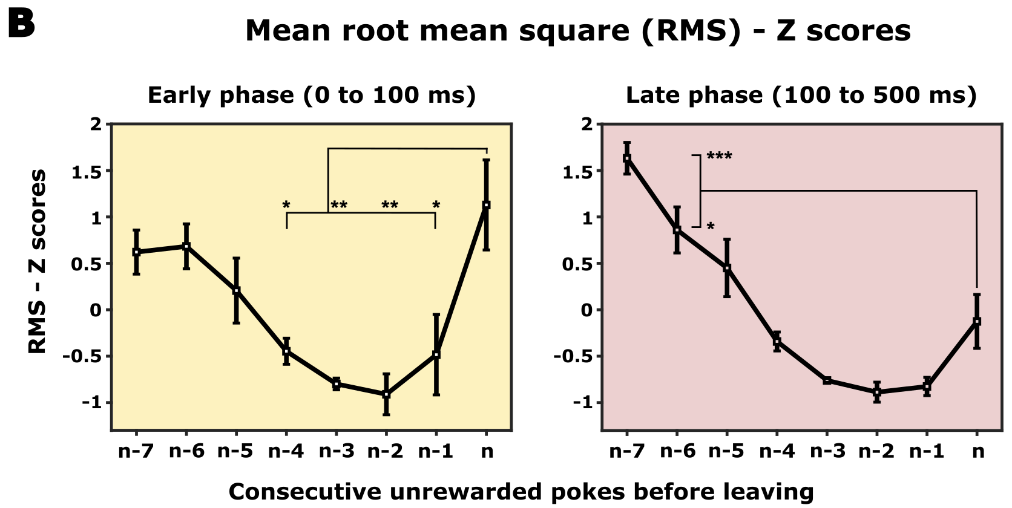

Shifts in frontal activity patterns: Exploitation to exploration
What makes the last poke the last one?

Slide 16
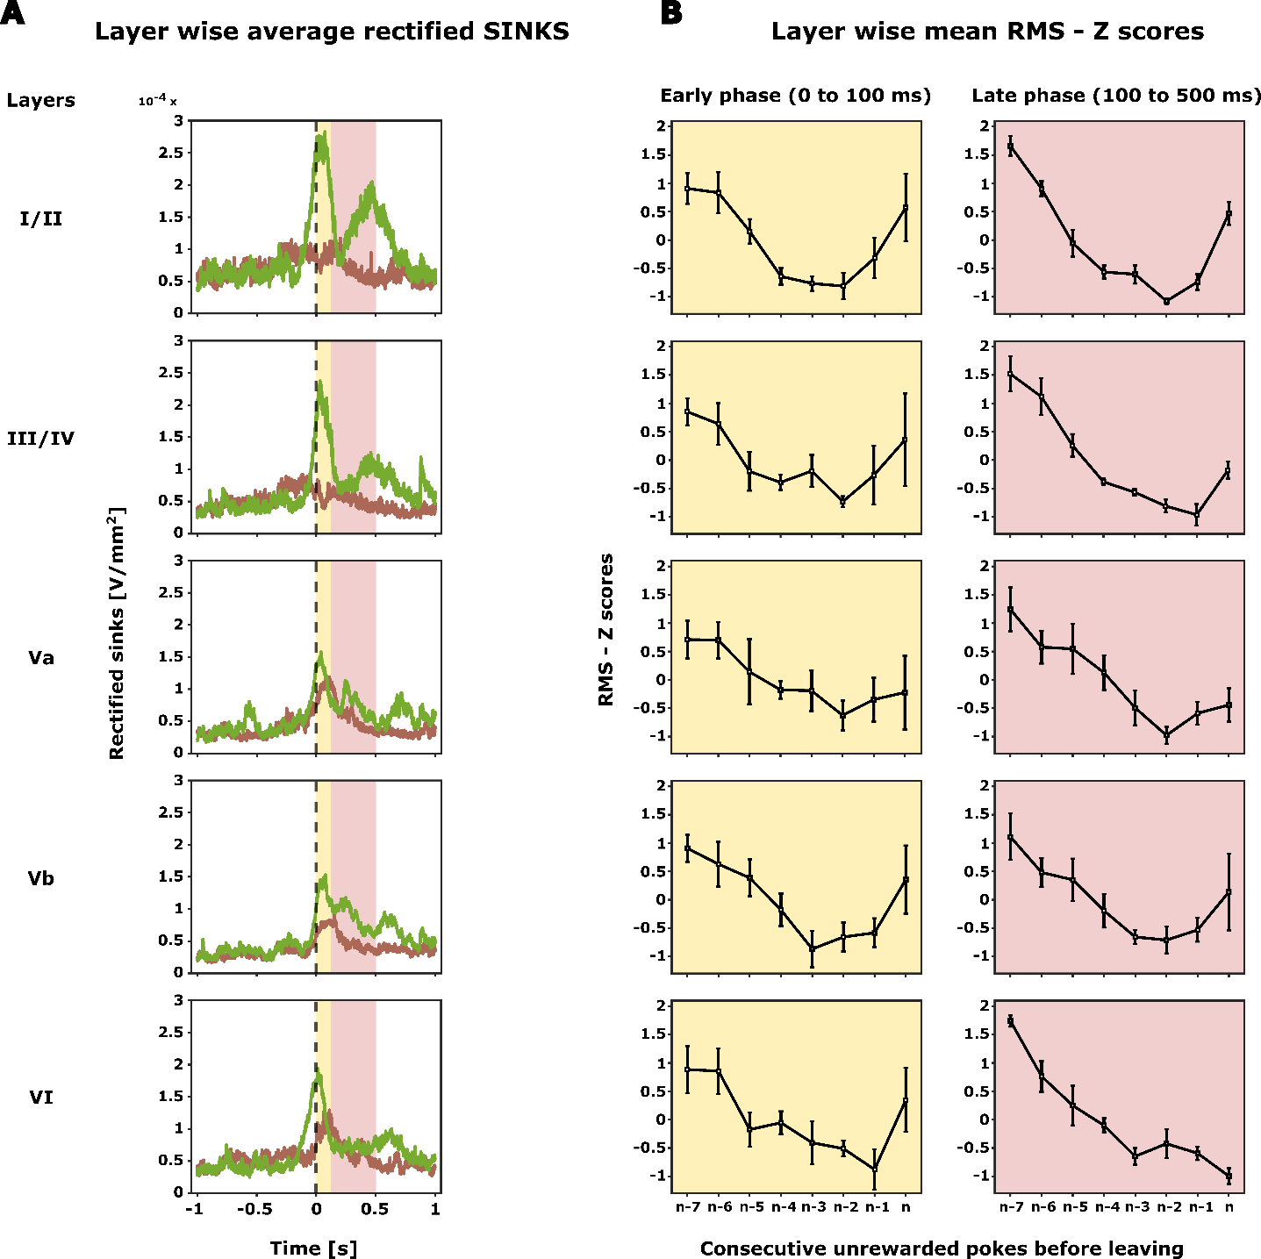
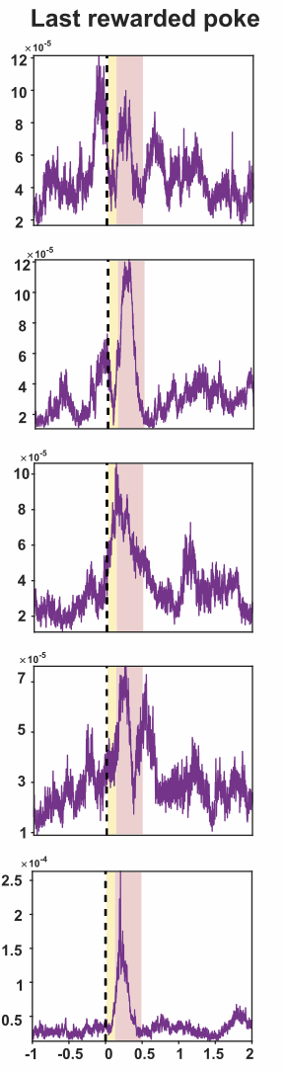
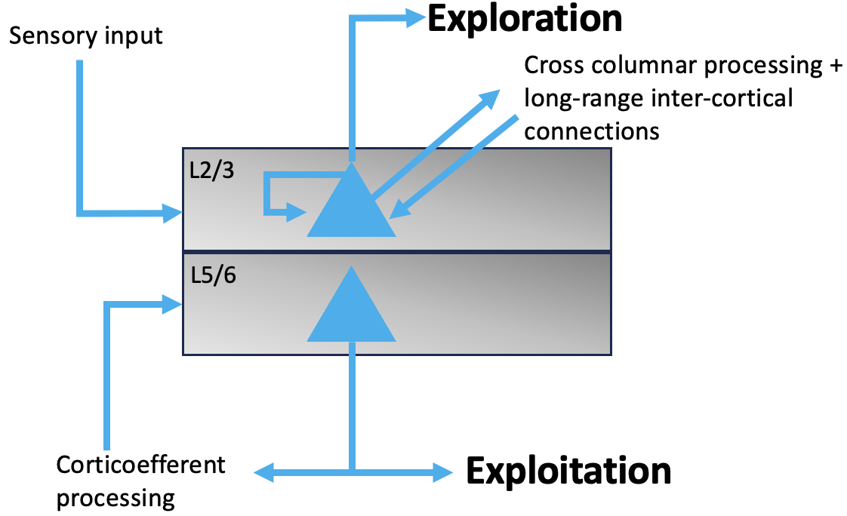
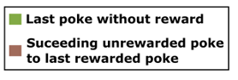
Shifts in layer specific activity patterns: Exploitation to exploration
1. Shift from deeper to upper layers
2. During the phase of switching from exploitation to exploration, initially, activity decreases in all cortical layers.
3. At the beginning of exploration, the activity in layer I/II and III/IV increases in the early phase.

Slide 17
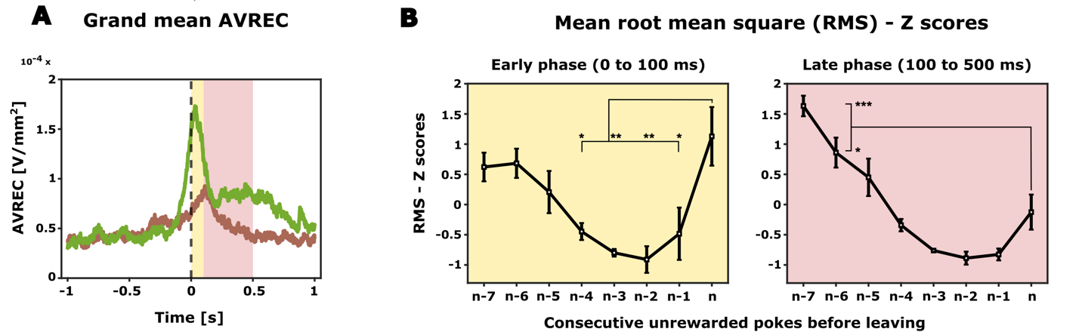
Summary
Probabilistic foraging
Animals make inference based decision
Increase in overall frontal activity just before the animal decides to explore
Cortical layers in frontal cortex seem to play a decisive role by altering current expectation and adopting adequate search strategies
To investigate the role of frontal cortex in exploration/exploitation dilemma and attentional resource allocation.

Slide 18
Future directions
Reinforcement Learning Modeling can help to investigate the trial-by-trial parameters, that underlie animal's inference-bound adaptive decision-making behavior, providing insights into the neural circuitry of attentional resource allocation
Optogenetic intervention to understand the causal relationship
In a comparative foraging task in humans using high-field fMRI, we plan to observe if similar layer-specific functions during exploration/exploitation transitions can be demonstrated.

Slide 19
Future directions
Reinforcement Learning Modeling
Optogenetic intervention
Comparative foraging task in humans using high-field fMRI

Slide 20
Next stop - PhD
Me
Experiment
Computation
Animal behaviour and its underlying neural circuits
- adaptive decision making
- sensory/ context perception

Slide 21
Thank you

Slide 22
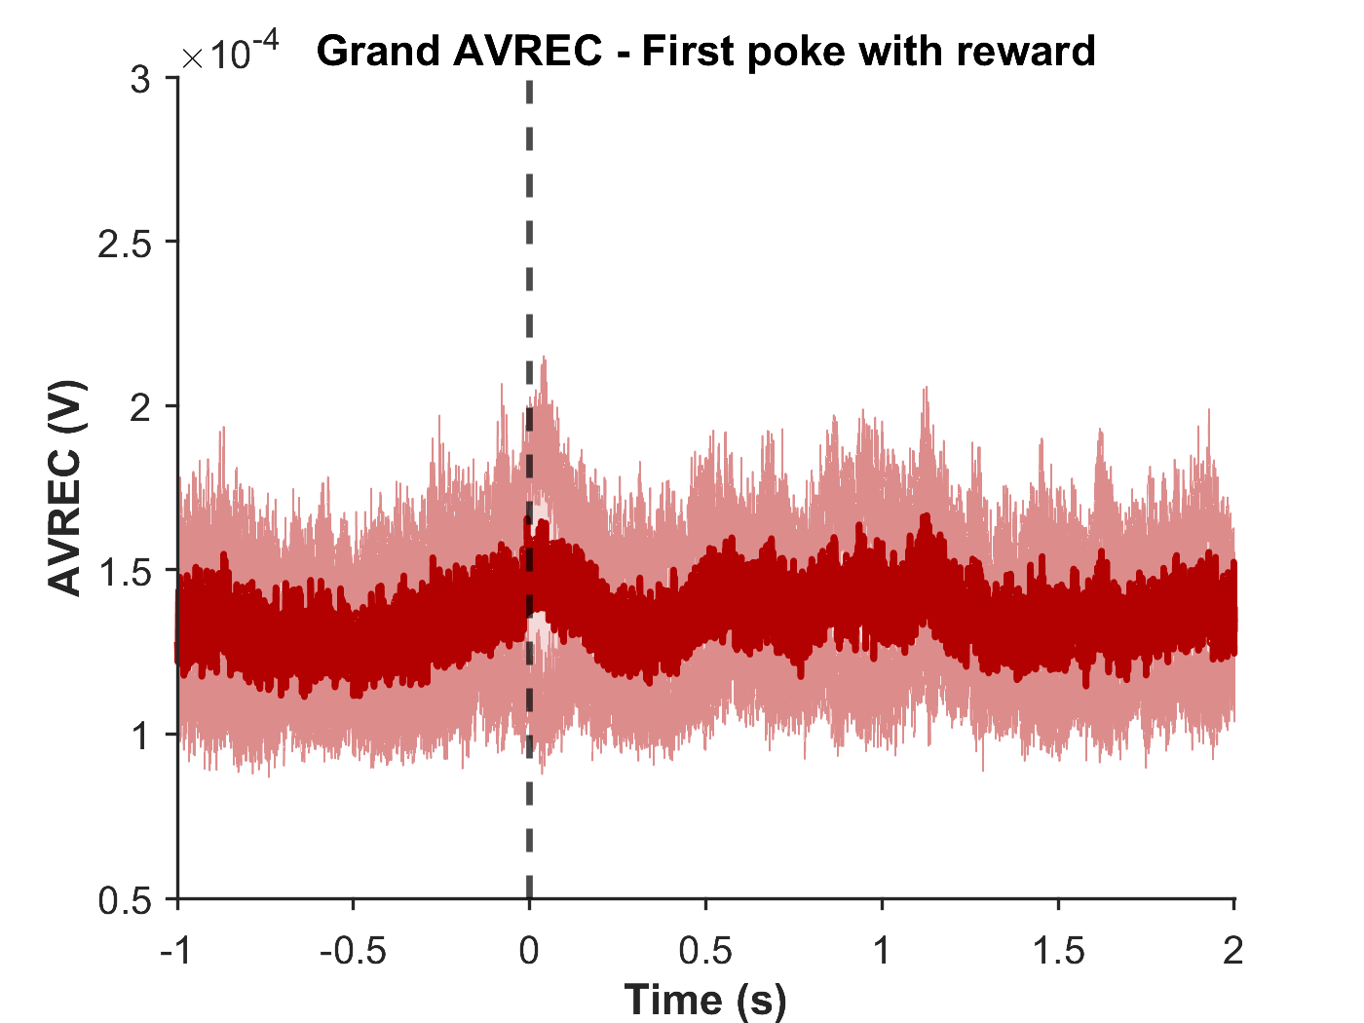
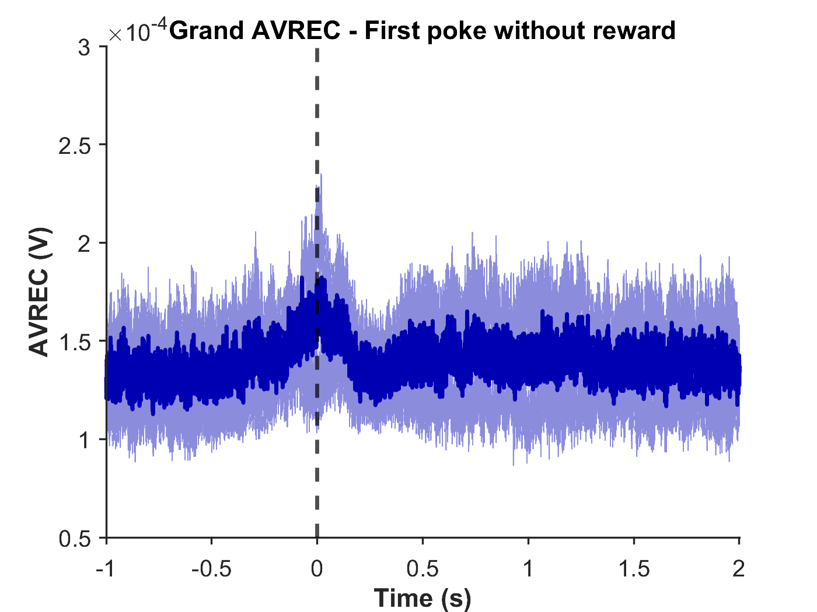
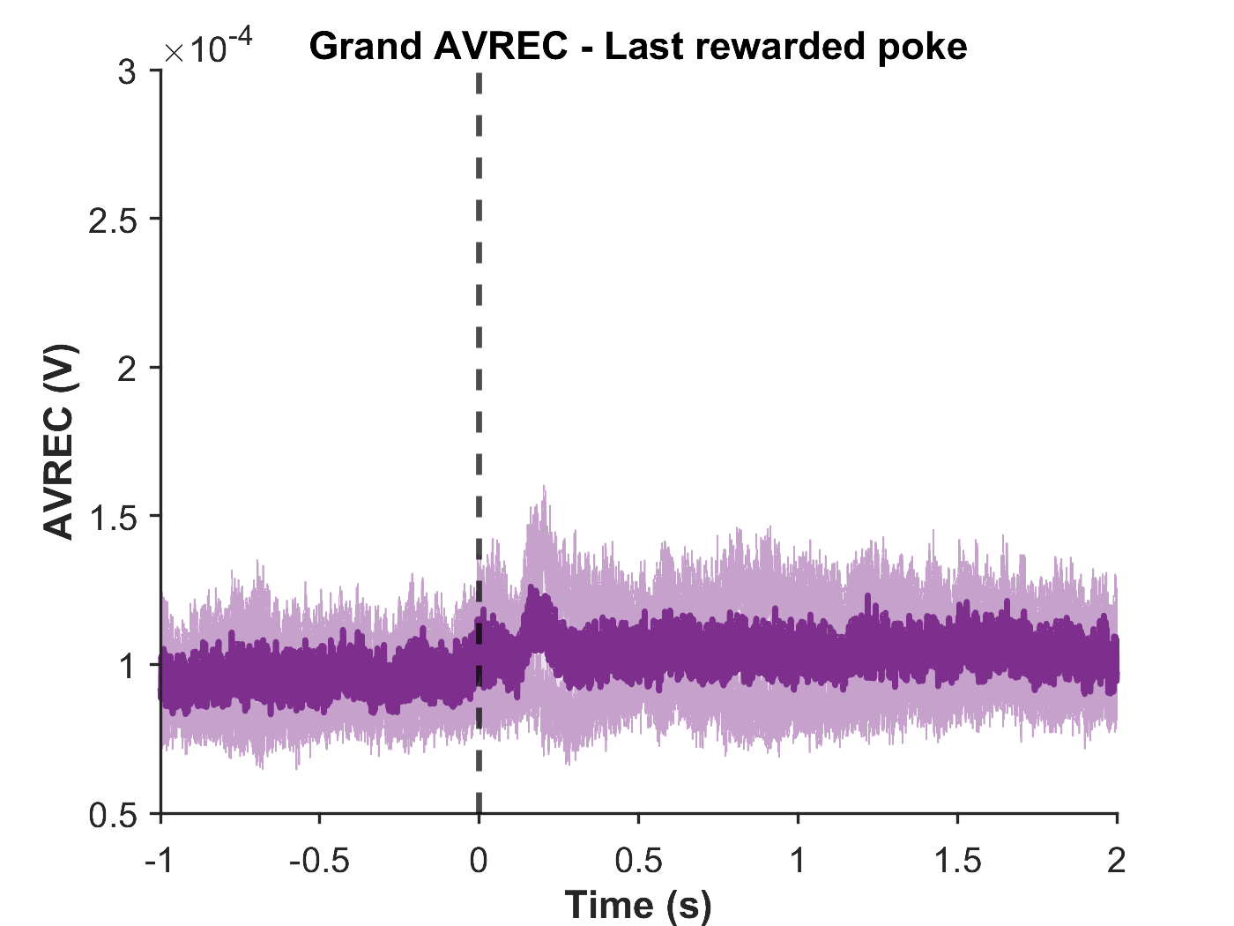
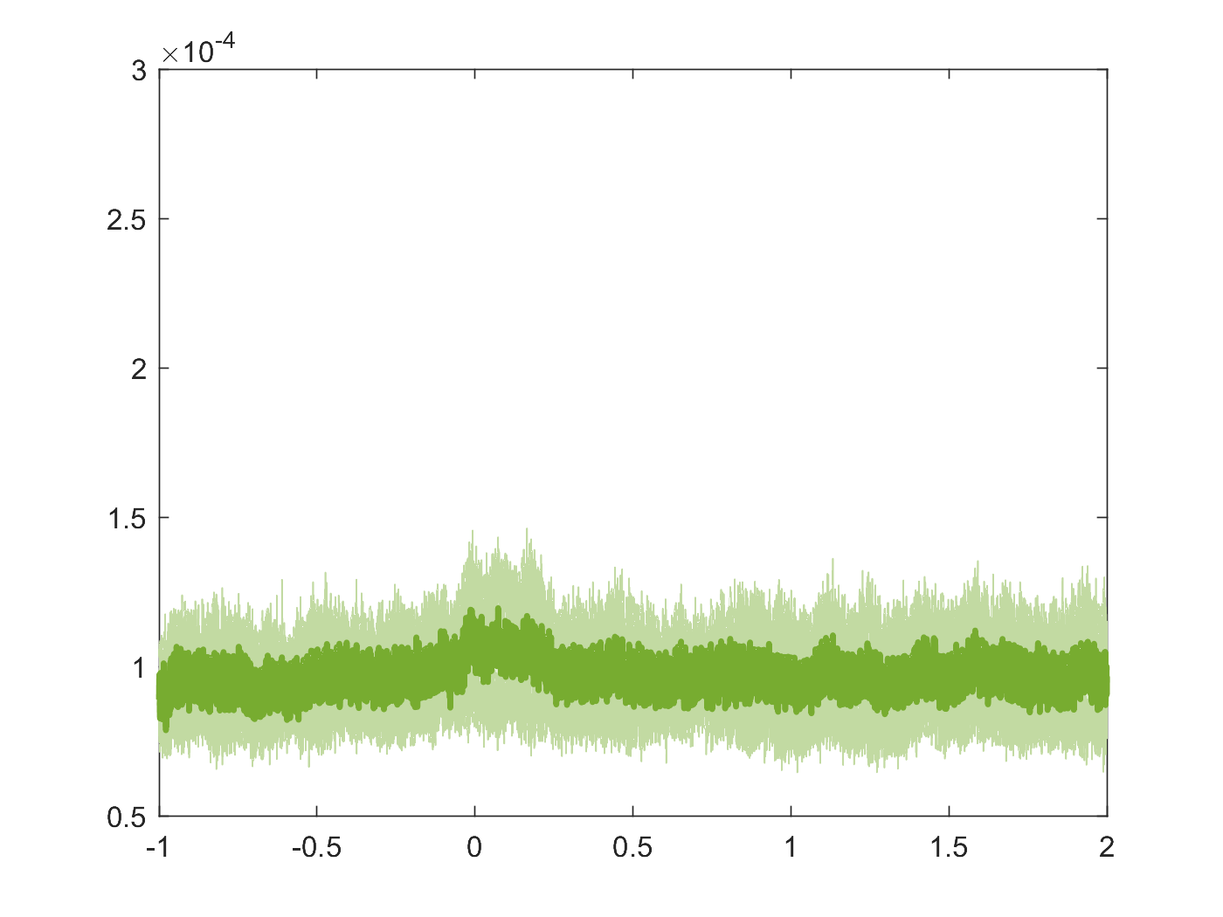
Signal from motor cortex
(4mm from bregma, motor cortex)
(4.65mm from bregma)

Slide 23
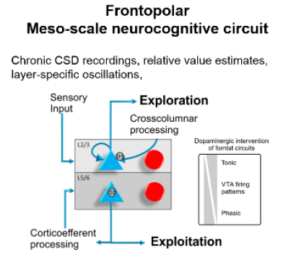
Exploration
Sensory input
Cross columnar processing + long-range inter-cortical connections
L2/3
L5/6
Corticoefferent processing
Exploitation

